Slide 1

ISP550 INFORMATION SYSTEMS ENGINEERING
Topic 5: Requirements Elicitation
OCTOBER 2025 – FEBRUARY 2026

Slide 2
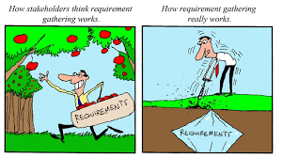

Slide 3
Learning Objectives
Define Requirements and Requirements Engineering
Describe Requirements Engineering Activities
Describe traditional and contemporary requirements elicitation techniques
Document workflows with activity diagram
Describe the types of requirements

Slide 4
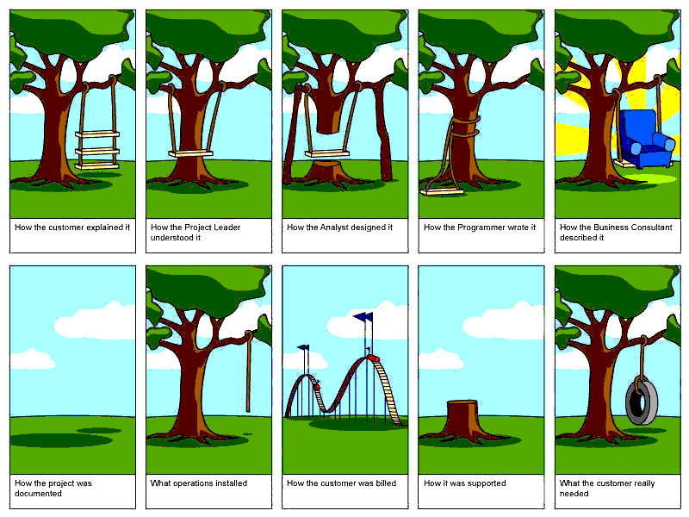
Requirements are considered as an input to design, implementation and validation
phase of software product development. Thus, a software project is successful or a failure during software development because of poor requirement elicitation as well as in requirements managing process (Pfleeger and Atlee, 2006).
In summary, there are many reasons for software project failures; however, poorly engineered requirements process contributes immensely to the reason why software projects fail (Inam, 2015).

Slide 5
Definition of Requirements & Requirements Engineering
Requirements:
A condition or capability needed by a user to solve a problem or achieve an objective.
Requirements Engineering:
A systematic and disciplined approach to the specification and management of requirements

Slide 6
Requirements Engineering Activities
The activities used for Requirements Engineering vary widely depending on the application domain, the people involved and the organisation developing the requirements.
However, there are a number of generic activities common to all processes
Requirements elicitation;
Requirements analysis;
Requirements validation;
Requirements management.
In practice, RE is an iterative activity.

Slide 7
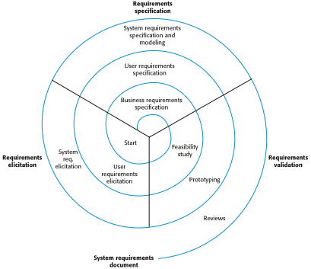
A Spiral View of the RE Process

Slide 8
Traditional Methods of Eliciting Requirements
Traditional Methods of Eliciting Requirements
Individually interview people informed about the operation and issues of the current system and future systems needs
Interview groups of people with diverse needs to find synergies and contrasts among system requirements
Observe workers at selected times to see how data are handled and what information people need to do their jobs
Study business documents to discover reported issues, policies, rules, and directions as well as concrete examples of the use of data and information in the organization
Distributing questionnaire

Slide 9
Contemporary Methods of Eliciting Requirements
Contemporary Methods of Eliciting Requirements
Bringing session users, sponsors, analysts, and others together in a J A D session to discuss and review system requirements
Iteratively developing system prototypes that refine the understanding of system requirements in concrete terms by showing working versions of system features
A JAD is a Joint Application Development (or Design) session. It is an opportunity for stakeholders with different points of view to come together to understand business requirements and brainstorm what the best technical approach might be for meeting the customer's needs.

Slide 10
Requirements Elicitation
Problems discovered during Requirements Elicitation
Problems of scope: The boundary of system is ill-defined. Or unnecessary details are provided.
Problems of understanding: The users are not sure of what they need, and don’t have full understanding of the problem domain.
Problems of volatility: the requirements change overtime.

Slide 11
Requirements Elicitation
Guidelines of Requirements Elicitation
Assess the business and technical feasibility for the proposed system
Identify the people who will help specify requirements.
Define the technical environment (e.g. computing architecture, operating system, telecommunication needs) into which the system or product will be placed
Identify “domain constraints” (i.e. characteristics of the business environment specific to the application domain) that limit the functionality or performance of the system or product to build
Define one or more requirements elicitation methods (e.g. interviews, team meetings, ..etc)
Solicit participation from many people so that requirements are defined from different point of views.
Create usage scenarios of use cases to help customers/ users better identify key requirements.

Slide 12
Interviewing
Formal or informal interviews with stakeholders are part of most requirements elicitation processes.
Types of interview
Closed interviews based on pre-determined list of questions
Open interviews where various issues are explored with stakeholders.
Effective interviewing
Be open-minded, avoid pre-conceived ideas about the requirements and are willing to listen to stakeholders.
Prompt the interviewee to get discussions going using a springboard question, a requirements proposal, or by working together on a prototype system.

Slide 13
Interviewing Users and Other Stakeholders
Prepare detailed questions
Meet with individuals or groups of users
Obtain and discuss answers to the questions
Document the answers
Follow up as needed in future meetings or interviews

Slide 14
Themes for Information Gathering Questions

Slide 15
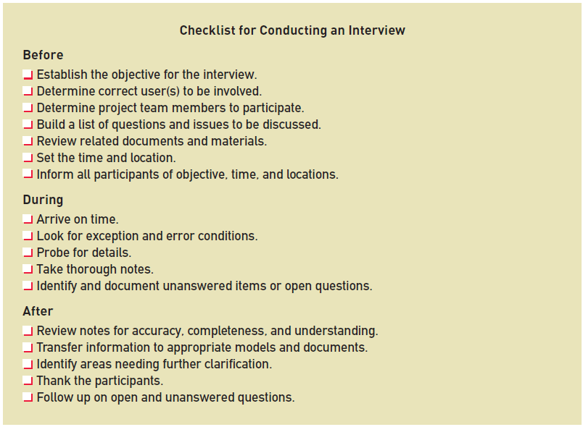
Preparing for Interview

Slide 16
Interview Session Agenda

Slide 17
Interviews in Practice
Normally a mix of closed and open-ended interviewing.
Interviews are good for getting an overall understanding of what stakeholders do and how they might interact with the system.
Interviews are not good for understanding domain requirements
Requirements engineers cannot understand specific domain terminology;
Some domain knowledge is so familiar that people find it hard to articulate or think that it isn’t worth articulating.

Slide 18
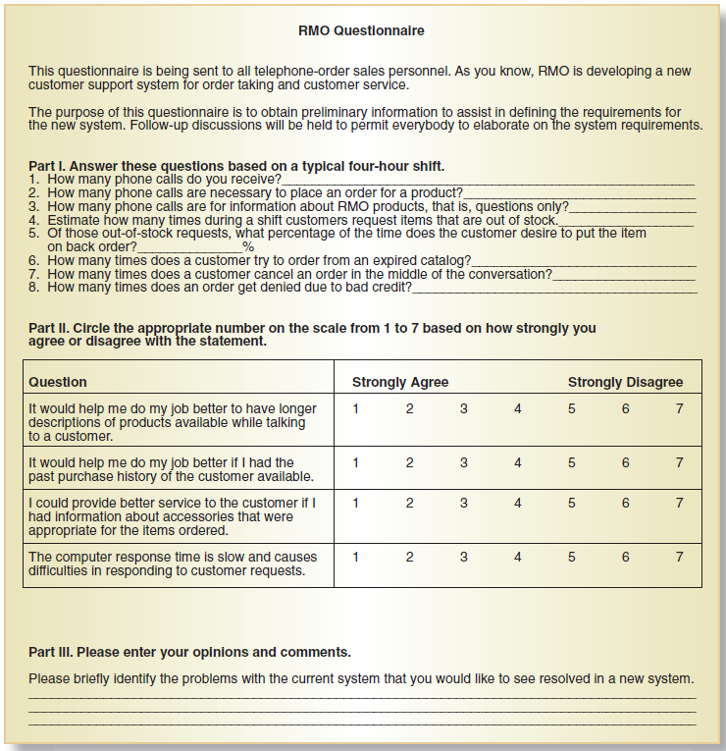
Distribute and Collect Questionnaires

Slide 19
Review Inputs, Outputs, and Procedures

Slide 20
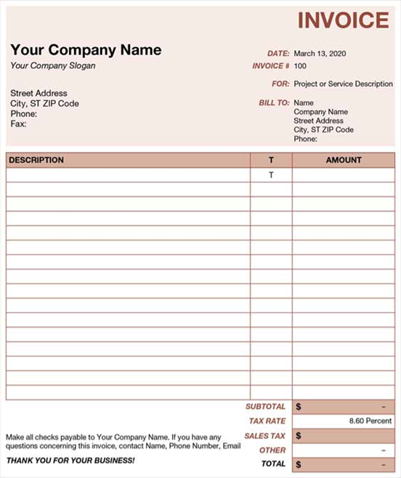
An Invoice Form from Microsoft Excel
(Source: Microsoft Corporation)

Slide 21
Comparison of Observation and Document Analysis
Characteristic | Observation | Document Analysis
Information Richness | High (many channels) | Low (passive) and old
Time Required | Can be extensive | Low to moderate
Expense | Can be high | Low to moderate
Chance for Follow-Up and Probing | Good: probing and clarification questions can be asked during or after observation | Limited: probing possible only if original author is available
Confidentiality | Observee is known to interviewer; observee may change behavior when observed | Depends on nature of document; does not change simply by being read
Involvement of Subject | Interviewees may or may not be involved and committed depending on whether they know if they are being observed | None, no clear commitment
Potential Audience | Limited numbers and limited time (snapshot) of each | Potentially biased by which documents were kept or because document was not created for this purpose

Slide 22
Documenting Workflows with Activity Diagrams
Workflow– sequence of processing steps that completely handles one business transaction or customer request
Activity Diagram– describes user (or system) activities, the person who does each activity, and the sequential flow of these activities
Useful for showing a graphical model of a workflow
A UML diagram

Slide 23
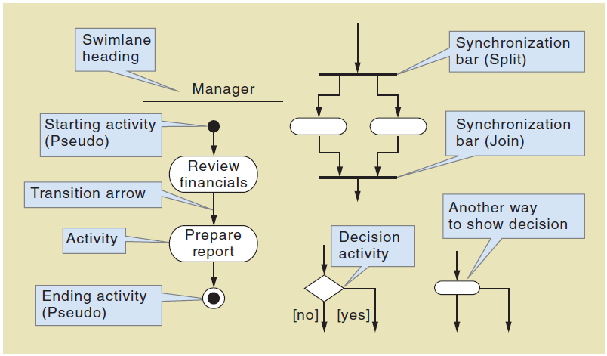
Activity Diagrams Symbols

Slide 24
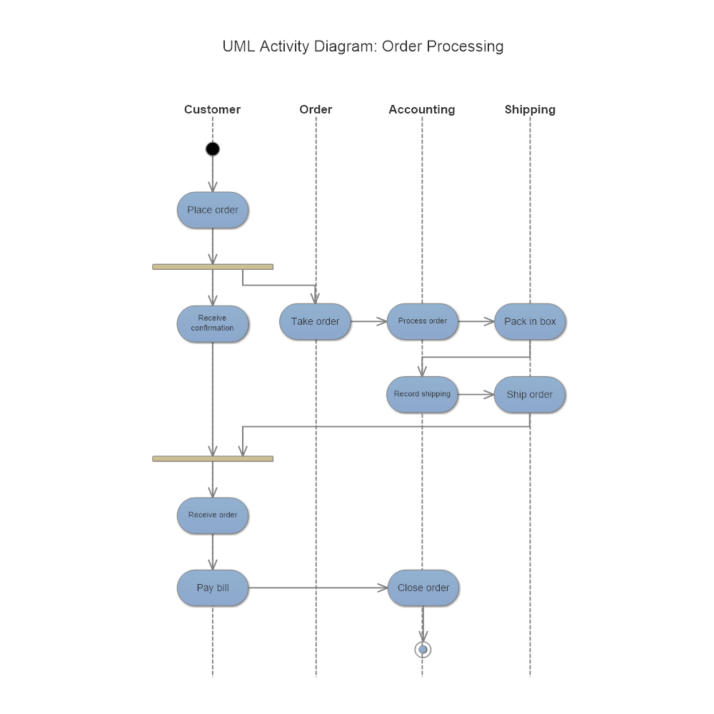
Activity diagram example (1)

Slide 25
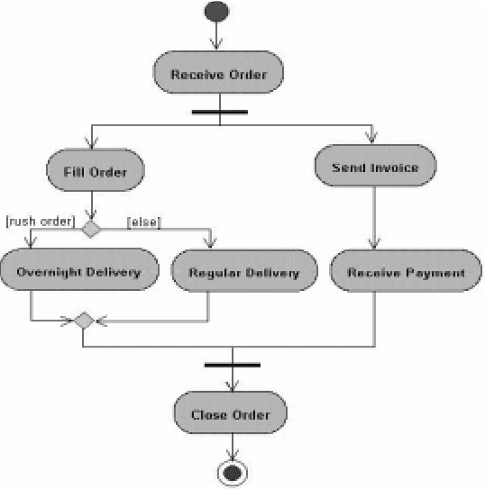
Activity diagram example (2)

Slide 26
Types of Requirements (1/2)
Functional Requirements:
Defines functions of a software system or its components. They may be calculations, technical details, data manipulation and processing and other specific functionality that define “what a system is supposed to accomplish?”
They describe particular results of a system.
Functional requirements are supported by Non-functional requirements.

Slide 27
Types of Requirements (2/2)
Non-Functional Requirements:
They are requirements that specify criteria that can be used to judge the operation of a system, rather than specific behavior.
Functional requirements define what the system is supposed to do, whereas non-functional requirements define how a system is supposed to be.
Non-functional requirements can be divided into two main categories:
Execution qualities, such as security and usability, which are observable at runtime.
Evolution qualities, such as testability, maintainability and scalability.

Slide 28
FURPS+ Requirements Acronym
Functional requirements
Usability requirements
Reliability requirements
Performance requirements
Security requirements
+ even more categories…

Slide 29
FURPS+ Requirements Acronym

Slide 30

Define Requirements and Requirements Engineering
Describe Requirements Engineering Activities
Describe traditional and contemporary requirements elicitation techniques
Document workflows with activity diagram
Describe the types of requirements

